Slide 1

LatentView Approach – DevOps Practices in Data Science
Feb 2019

Slide 2
Agenda
1
Why DevOps?
2
Evolution of DevOps to DataOps
3
DevOps Lifecycle, Stages, Toolchains
4
DevOps Best Practices for Data Science
5
Azure DevOps
6
Case Study
7
Proposed Engagement Structure

Slide 3
Why DevOps?
DevOps is more about a culture and is a set of processes that bring development and IT operations together to complete the software development/statistical modeling package. As per State of DevOps report, key metrics are -
IT organizations deploy 200 times more frequently, with 2,555 times faster lead times
High-performing IT teams spend 50 percent less time remediating security issues
1
2
They have 24 times faster recovery times and three times lower change failure rates
And they spend 22 percent less time on unplanned work and rework
3
4
Cost Curve Post Implementation of DevOps
Benefits of DevOps
Cost
Shorter development cycle, time to market
Increased cost advantage thanks to automation on CI/CD
Reduced deployment failure, time to recover
Improved communication and collaboration
Higher productivity & flexibility
Moving away from legacy to microservices leading to minimal impact to business services
More reliable releases, high scalability
Time (years)
0
1
2
Managed by LatentView
Automated

Slide 4
Evolution of DevOps to DataOps
Traditional Waterfall Model
Agile Methodology Model
DevOps Approach
Emerging Field: DataOps
Complete requirements are clear and fixed
Product definition is stable
Lack of communication between client and development team
Requirements change frequently
Development needs to be fast
Continuous feedback loop between client and development team
Requirements change frequently
Development and Operations need to be Agile
Good communication between development and operations team
DataOps is an automated, process-oriented methodology, used by analytics and data teams
Improves the quality and reduces the cycle time of data analytics.

Slide 5
What is DataOps?
DataOps is an automated, process-oriented methodology, used by analytics and data teams. It applies to the entire data lifecycle from data preparation to reporting, and recognizes the interconnected nature of the data analytics team and information technology operations.
DevOps
Data Science
DataOps
Maths, Statistics
Programming
Business Domain
Data Science
QA Testing
IT Operations
Agile Software Dev
DevOps
Data Engineers
Data Scientists
Developers & Architects
Operations
Security

Slide 6
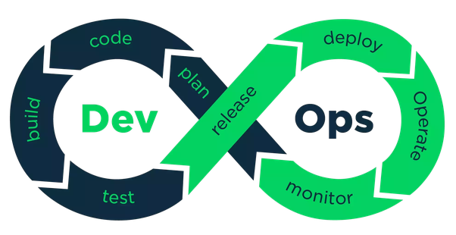
DevOps Lifecycle and Stages
DevOps Lifecycle
DevOps Stages
Continuous Development
Continuous Integration
Continuous Testing
Continuous Deployment
Continuous Monitoring
Continuous Iterations

Slide 7
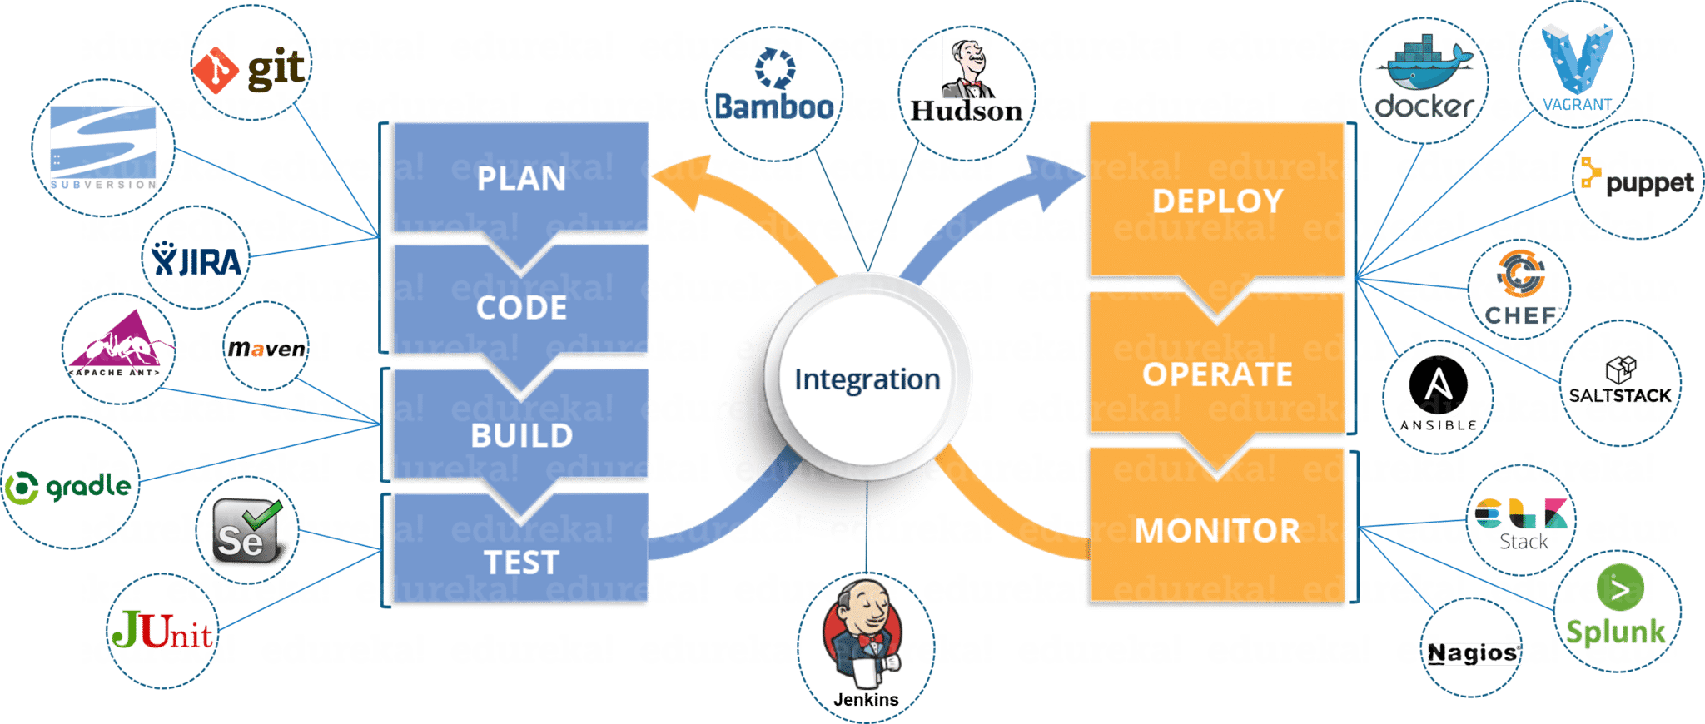
DevOps Toolchains

Slide 8
Overlapping of DevOps with Data Science Workflow
Formulate Data Science Problem
Data Collection
Data Cleaning
Data Exploration
Feature Engineering
Modeling
Validation
Iteration
Continuous Development and Integration
Continuous Building and Testing
Containers eliminate any chance of errors/ failure in production environment by packaging and replicating the same dependencies & packages used in development/ testing/ staging environment.
Ex: Docker
Continuous Deployment
Containerization/ Virtualization
Continuous Monitoring

Slide 9


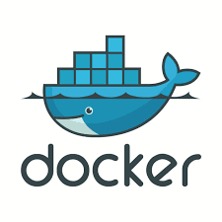
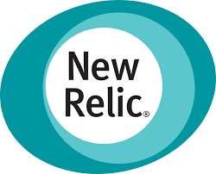

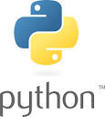
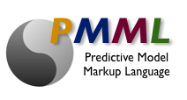
DevOps Best Practices for Data Science
Version Control
PMML
CI/CT/CD
Monitor
Security
Versions are maintained in a central repository
Developers + Operations can have access to the same code
During fault, ops can quickly rollback the deployed code and thus revert to the previous stable state.
Build Model
Check-in code
Build Deployment Package
Deploy
Monitor
DevSecOps refers to the discipline and practice of safeguarding the entire DevOps environment through strategies, policies, processes, and technology
Security should be built into every part of the DevOps lifecycle, including inception, design, build, test, release, support, maintenance, and beyond
PMML is the de facto standard to represent predictive solutions
It allows for different statistical and data mining tools to speak the same language
It may be developed in one application and directly deployed on another
Automating the process of delivering the code to Prod environment
Capitalize different types of environment: Development, Staging (Testing), Production
Canary Deployment using Load Balancing
Deploying models in Containers – Docker
Monitoring – Retrain the model during concept drift using recent data

Slide 10
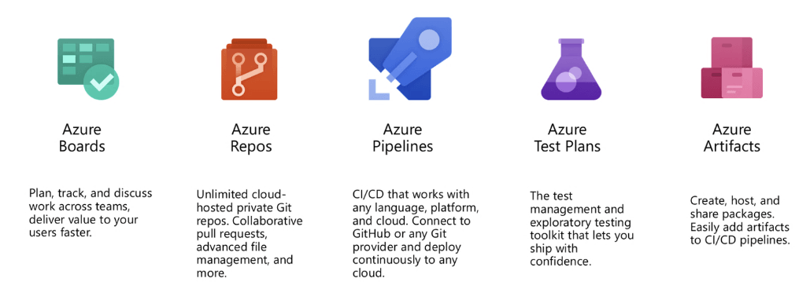
Azure DevOps

Slide 11
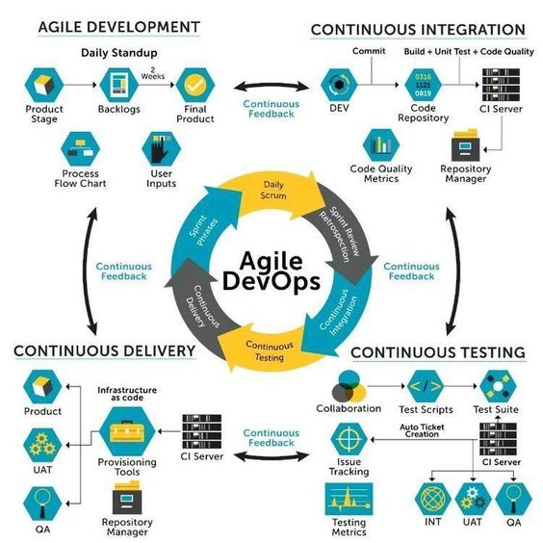
Agile DevOps

Slide 12

Case Study: Leveraging Version Control for Development
Client is a Leading Cosmetics Company in U.S.
Business Objective
Loyal consumers of the client’s cosmetics line was aging and the impression of the brand had been in steady decline among younger women for the past few years
LatentView Solution
Building a social insights platform to mine the rich data of the target demographic in social media to spot trends, rate influencers, identify upcoming competitors etc.
Business Benefits
Ability to score trends that could become mainstream ahead of time helped the company to improve their product launch success rate by 5% in the first 6 months
Development
Versions
Versions
Sandbox
Production
1
Master Codebase
1
Sandbox
Codebase
Production Codebase
2
Branch 1
Branch 4
2
build
test
deploy
Branch 2
Branch 3
1
1
2
2
3
commit

Slide 13














Proposed Engagement Structure
Roles & Responsibilities
STEERING COMMITTEE
Primary interface with Client business leaders
Work with Client team to identify and prioritize analytic opportunities
SENIOR MANAGEMENT
SENIOR MANAGEMENT
Engagement Manager
Primary interface to the Engagement Manager
Ensures seamless workflow management, quality control and delivery schedule management
Client
LatentView Onshore Team
LatentView
Offshore Team
Project Manager
Dedicated analyst team with experience in various analytics projects
Expertise in techniques such as data analysis, visualization, modelling, etc and analytics tools such as QlikView, SQL, Python, R, SPSS, SAS, etc.
Client Program
Manager
Engagement Manager
Project Manager
Core Analyst Team
…
Project A
Project Z
Specialized support on demand across projects
Experts with a wide variety of skill sets including Advanced Modeling, Enterprise reporting, Software Development, etc.
Scalable Analyst Team
Client Team
On-site Data Analysts
Team Lead
Team Lead
On-Demand
Analysts
Data Analysts
Data Analysts

Slide 14
Appendix

Slide 15
Thank You

